Slide 1
AVL Trees

Slide 2
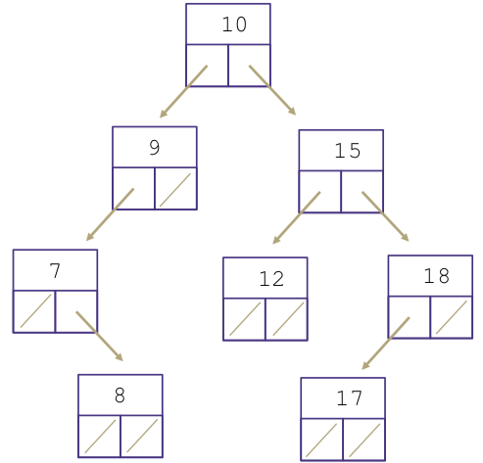
Review: BST

Slide 3
Problem 1A
Valid BST?
7
6
43
2

Slide 4
Problem 1A
Valid BST?
No!
7
6
43
2

Slide 5
Problem 1A
Valid AVL?
7
6
43
2

Slide 6
Problem 1A
Valid AVL?
No!
(Must be BST to be AVL!)
7
6
43
2

Slide 7
Problem 1B
Valid BST?
43
7
59
6
42
63
11
21

Slide 8
Problem 1B
Valid BST?
Yes!
43
7
59
6
42
63
11
21

Slide 9
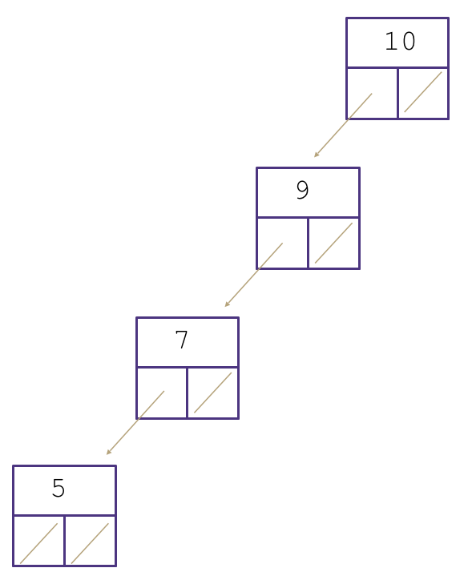
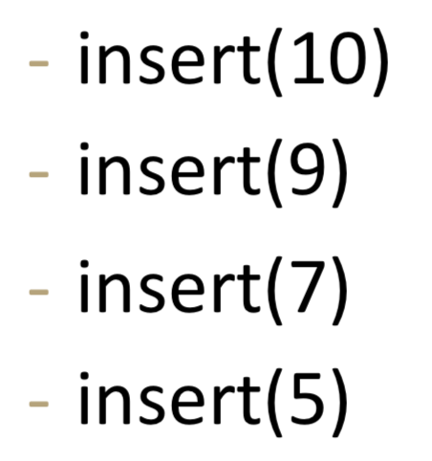
But, a problem...
Normal BSTs can become unbalanced. So find is slow.

Slide 10
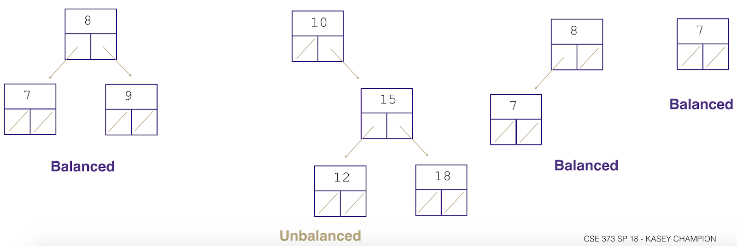
What exactly does balanced mean?
For every node, compare the heights of its two sub trees.
Balanced when the difference in height between sub trees is no greater than 1 for every node.

Slide 11
What exactly does balanced mean?
Note: Balanced tree with n items has height of O(log(n)).

Slide 12
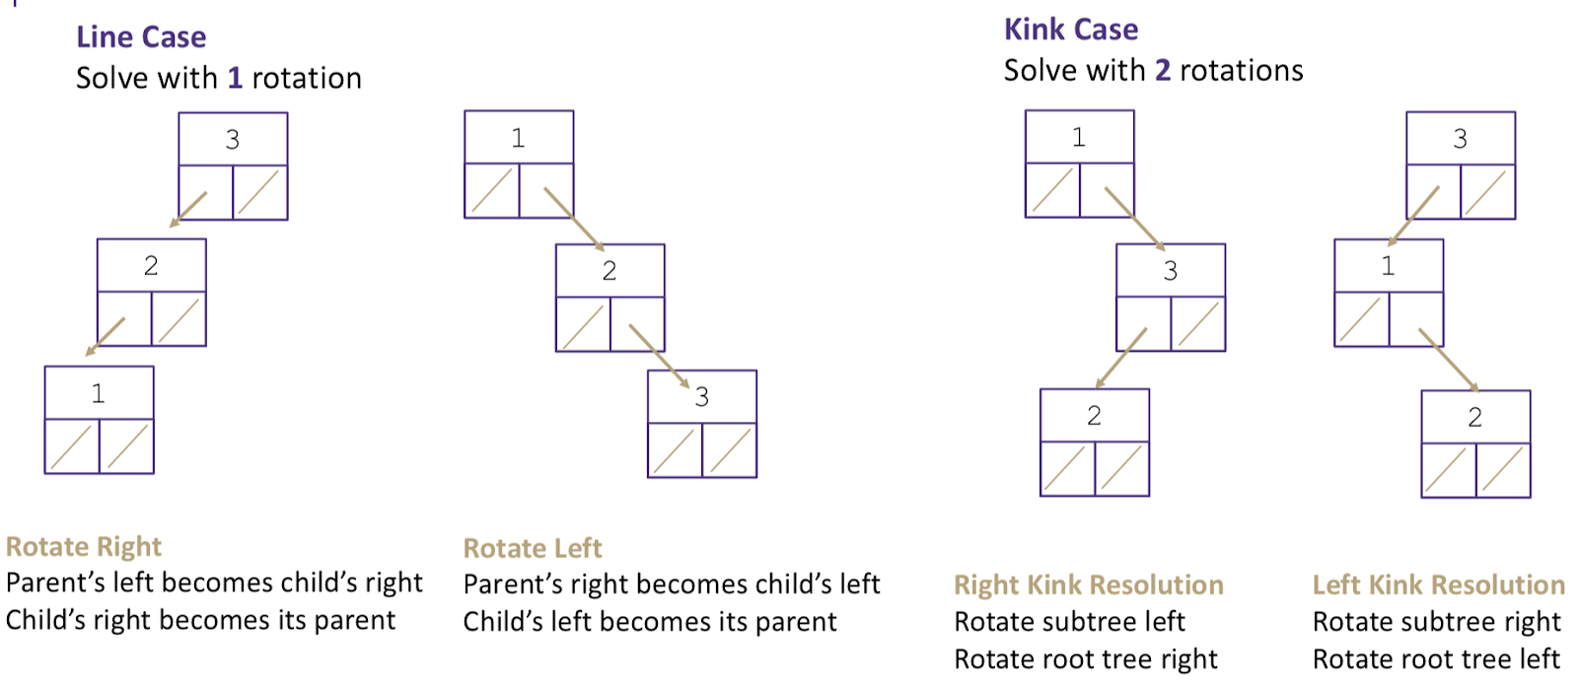

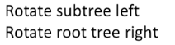
Solution: AVL Trees
These special BSTS remain balanced no matter what order items are inserted in. They do this by rebalancing themselves using rotations each time an item gets inserted.

Slide 13
Problem 1B
Valid AVL?
43
7
59
6
42
63
11
21

Slide 14
Problem 1B
Valid AVL?
No!
42 violates
Balance condition.
43
7
59
6
42
63
11
21

Slide 15
Problem 1C
Valid BST?
43
7
59
6
21
63
11
42

Slide 16
Problem 1C
Valid BST?
Yes!
43
7
59
6
21
63
11
42

Slide 17
Problem 1C
Valid AVL?
43
7
59
6
21
63
11
42

Slide 18
Problem 1C
Valid AVL? Yes!
43
7
59
6
21
63
11
42

Slide 19
Big O
Write down a tight big-O for each of the following. Unless otherwise noted, give a bound in the worst case
(a) Insert and find in a BST.

Slide 20
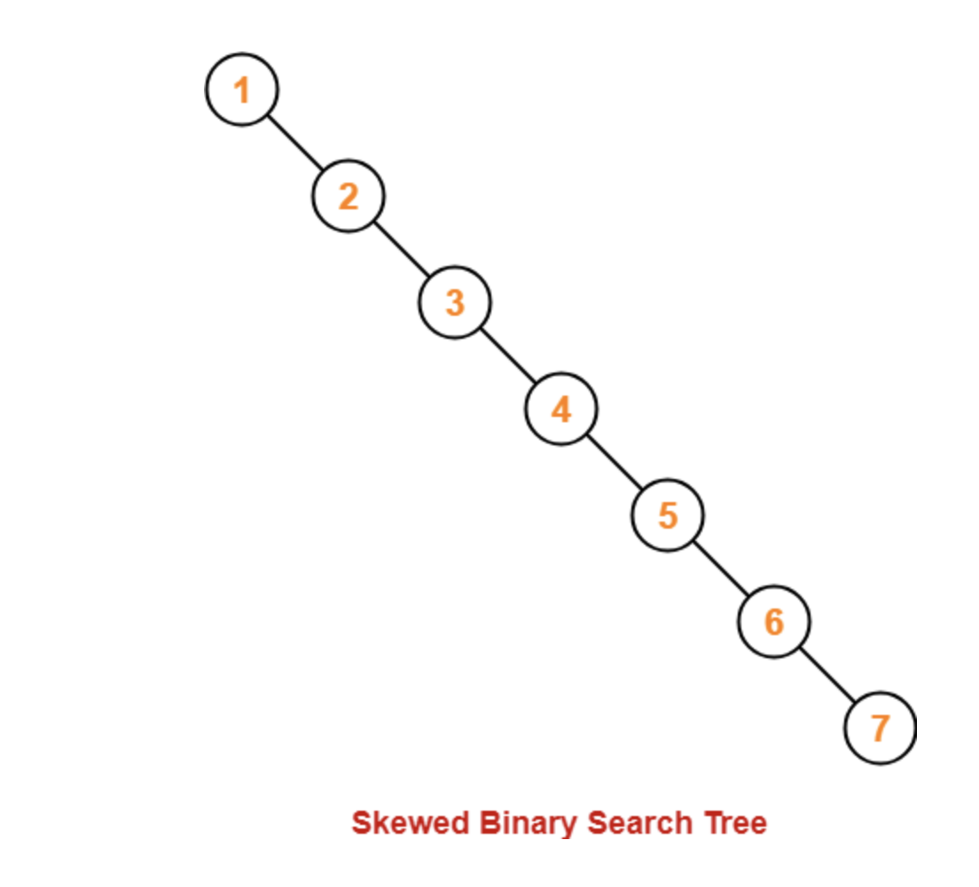
Big O
Insert: Inserting biggest/smallest item at the bottom of the tree
Find: FInding Biggest/smallest item in the skewed binary tree
Let’s think about worst case : Linked List like tree
O(N)
O(N)

Slide 21
Big O
Write down a tight big-O for each of the following. Unless otherwise noted, give a bound in the worst case
(b) Insert and find in AVL Tree

Slide 22
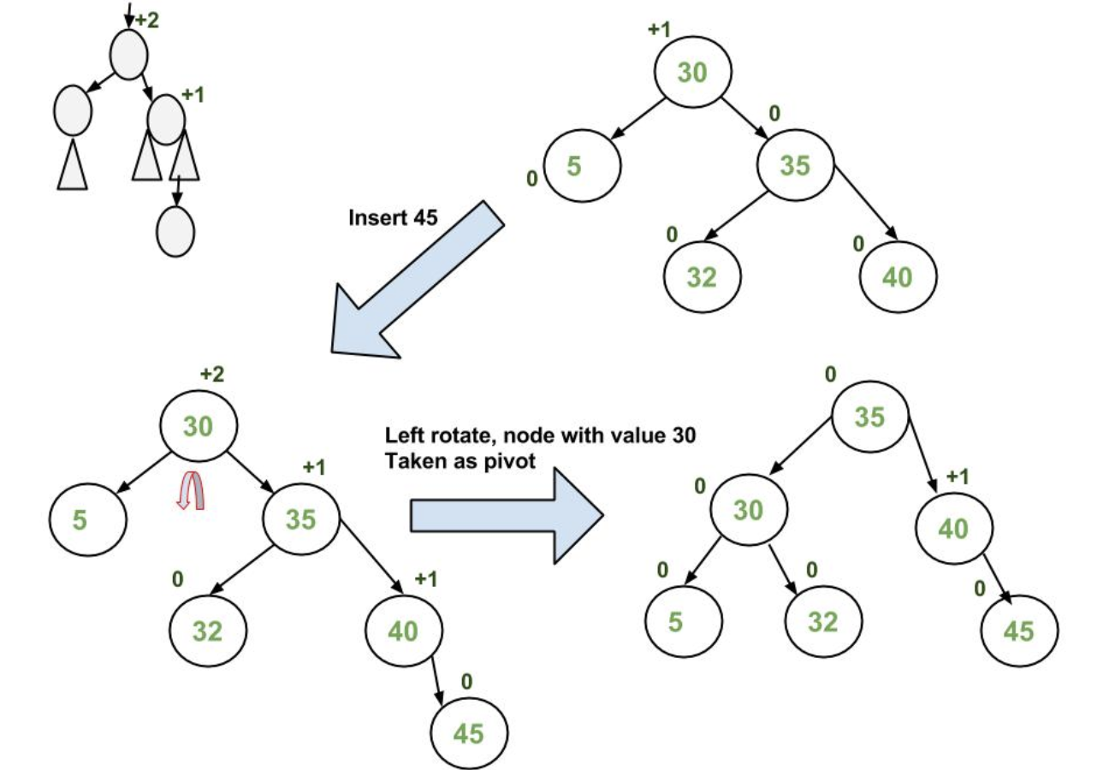
Big O
Insert: Balanced tree height is log(N)
Find: Balanced tree height is log(N)
O(log(N))
Let’s think about worst case: Insert/find at the bottom of our tree
O(log(N))

Slide 23
Big O
Write down a tight big-O for each of the following. Unless otherwise noted, give a bound in the worst case
(c) Finding the minimum value in an AVL tree containing
N elements

Slide 24
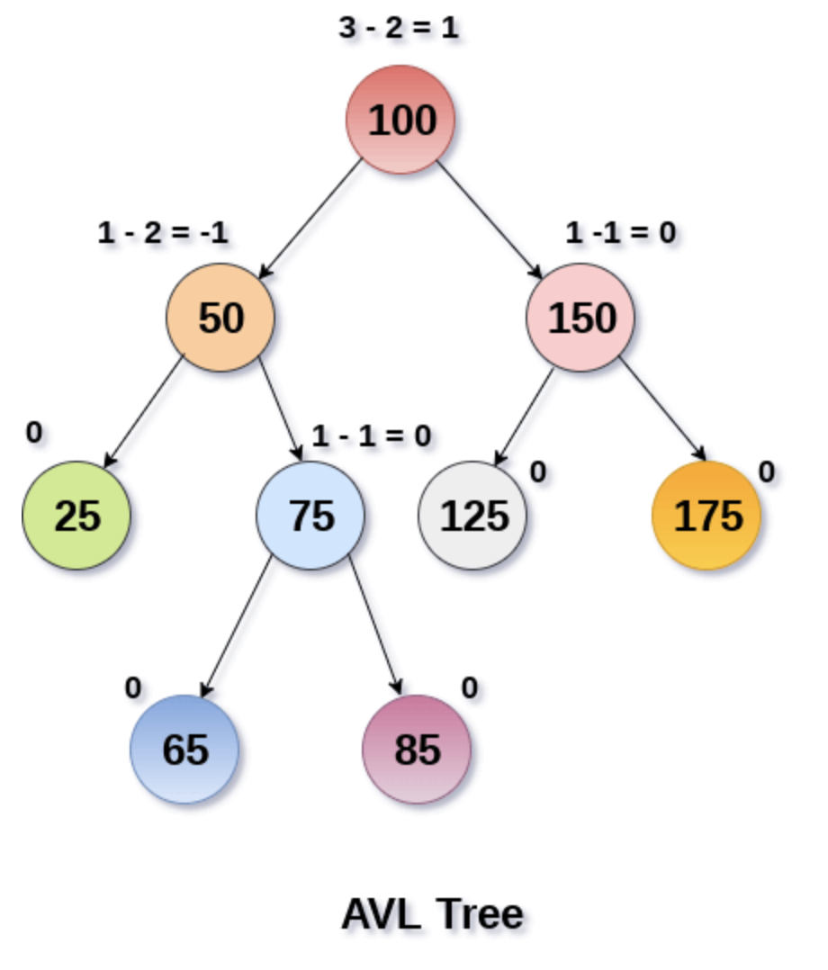
Big O
Find: AVL tree is balanced
Finding value by starting from root
and traverse to the left most branch
O(log(N))
Let’s think about worst case:

Slide 25
BST: Efficiency of Operations?
Problem:
Worst-case running time:
find, insert, delete
buildTree

Slide 26
How can we make a BST efficient?
Observation
Solution: Require a Balance Condition that
When we build the tree, make sure it’s balanced.
BUT…Balancing a tree only at build time is insufficient.
We also need to also keep the tree balanced as we perform operations.

Slide 27
Potential Balance Conditions
Left and right subtrees
Left and right subtrees

Slide 28
Potential Balance Conditions
Left and right subtrees
Left and right subtrees

Slide 29
Potential Balance Conditions
Left and right subtrees

Slide 30
AVL Tree (Bonus material: etymology)
Invented by Georgy Adelson-Velsky and Evgenii Landis in 1962

Slide 31
The AVL Tree Data Structure
An AVL tree is a self-balancing binary search tree.
Structural properties
Binary tree property (same as BST)
Order property (same as for BST)
Balance condition: balance of every node is between -1 and 1 where balance(node) = height(node.left) – height(node.right)
Result: Worst-case depth is

Slide 32
Example #1: Is this an AVL Tree?
Balance Condition: balance of every node is between -1 and 1 where balance(node) = height(node.left) – height(node.right)
6
4
8
1
7
11
10
12

Slide 33
Example #2: Is this an AVL Tree?
6
Balance Condition: balance of every node is between -1 and 1 where balance(node) = height(node.left) – height(node.right)
4
8
1
5
7
11
3
2

Slide 34
AVL Trees
Good News:
Because height of AVL tree is O(log(n)), then find
But as we insert and delete elements, we need to:

Slide 35
AVL Trees
3
10
2
2
5
20
0
1
1
0
2
9
15
30
0
0
7
17

Slide 36
AVL tree operations
AVL find:
Same as usual BST find
AVL insert:
AVL delete:
The “easy way” is lazy deletion
Otherwise, do the deletion and then check for several imbalance cases (we will skip this)

Slide 37
First insert example
Insert(6)
Insert(3)
Insert(1)
Third insertion
What’s the only way to fix it?

Slide 38
Fix: Apply “Single Rotation”
Single rotation: The basic operation we’ll use to rebalance
Move child of unbalanced node into parent position
Parent becomes the “other” child (always okay in a BST!)
Other subtrees move in only way BST allows (we’ll see in generalized example)
AVL Property violated at node 6
6
3
3
1
6
1

Slide 39
Tree Rotations: Generalized

Slide 40
Generalizing our examples…
12
5
23
2
9
18
30
1
4
7
10

Slide 41
Generalizing our examples…
12
5
23
2
9
18
30
1
4
7
10

Slide 42
Generalizing our examples…
12
5
E
A
C

Slide 43
Generalizing our examples…
d
12
b
E
A
C

Slide 44
Generalized Single Rotation
d
b
E
A
C

Slide 45
Generalized Single Rotation
b
A
d
C
E

Slide 46
Single Rotations
(Figures by Melissa O’Neill, reprinted with her permission to Lilian)

Slide 47
AVL Tree insert (more specific):
Insert the new node as in our generic BST (a new leaf)
For each node on the path from the root to the new leaf, the insertion may (or may not) have changed the node’s height
So after insertion in a subtree,

Slide 48
Case #1:
d
b
E
A
C
a’
(Figures by Melissa O’Neill, reprinted with her permission to Lilian)

Slide 49
Example #2 for left-left case: insert(16)
15
8
22
4
10
19
24
3
6
17
20
16

Slide 50
Case #2:
(Figures by Melissa O’Neill, reprinted with her permission to Lilian)

Slide 51
Example for right-right case: insert(26)
15
15
8
22
8
24
4
10
19
24
4
10
22
25
3
6
3
6
19
23
23
25
26
26

Slide 52
Case #3:
(Figures by Melissa O’Neill, reprinted with her permission to Lilian)

Slide 53
A Better Look at Case #3:
(Figures by Melissa O’Neill, reprinted with her permission to Lilian)

Slide 54
Case #3: Right-Left Case (after one rotation)
right rotate
A way to remember it:
Move d to grandparent’s position. Put everything else in their only legal positions for a BST.
(Figures by Melissa O’Neill, reprinted with her permission to Lilian)

Slide 55
Practice time! Example of Case #4
Starting with this AVL tree:
60
Which of the following is the updated AVL tree after inserting 42?
30
80
10
50
A)
B)
C)
D)
42
30
50
50
30
60
10
50
30
60
30
60
10
50
80
42
60
80
10
42
80
10
42
80

Slide 56
(Extra space for your scratch-work)

Slide 57
Practice time! Example of Case #4
Starting with this AVL tree:
60
Which of the following is the updated AVL tree after inserting 42?
30
80
10
50
What’s the name of this case?
What rotations did we do?

Slide 58
Insert, summarized
Insert as in our generic BST
Check back up path for imbalance, which will be 1 of 4 cases:
Node’s left-left grandchild is too tall
Node’s left-right grandchild is too tall
Node’s right-left grandchild is too tall
Node’s right-right grandchild is too tall
Only occurs because
After the appropriate single or double rotation, the smallest-unbalanced subtree has the same height as before the insertion
So all ancestors are now balanced

Slide 59
AVL Tree Efficiency
Worst-case complexity of find:
Worst-case complexity of insert:
Worst-case complexity of buildTree:
Takes some more rotation action to handle delete…

Slide 60
Pros and Cons of AVL Trees
Arguments for AVL trees:
All operations logarithmic worst-case because trees are always balanced
Height balancing adds no more than a constant factor to the speed of insert and delete
Arguments against AVL trees:
Difficult to program & debug [but done once in a library!]
More space for height field
Asymptotically faster but rebalancing takes a little time
If amortized logarithmic time is enough, use splay trees (also in the text, not covered in this class)

Slide 61
AVL Tree Rotation Cheat-Sheet
(Just two of the four cases)

Slide 62
Single Rotations
(Figures by Melissa O’Neill, reprinted with her permission to Lilian)

Slide 63
Case #2: Left-Left Case
left rotate
(Figures by Melissa O’Neill, reprinted with her permission to Lilian)

Slide 64
Case #3: Right-Left Case (after two rotations)
left rotate
right rotate
A way to remember it:
Move d to grandparent’s position. Put everything else in their only legal positions for a BST.
(Figures by Melissa O’Neill, reprinted with her permission to Lilian)

Slide 65
Now, let’s see how we have to balance the AVL tree when a node is deleted from the AVL Tree and the balance factor becomes greater than 1 or less than -1.

Slide 66
Deletion

Slide 67
Now, let’s see how we have to balance the AVL tree whean a node is deleted from the AVL Tree and the balance factor becomes greater than 1 or less than -1.

Slide 68
AVL Trees (Deletion): 4 Cases

Slide 69
1. If BF(parent) > 1 a. If (BF(parent->left) >= 0) (Right Rotation) b. If (BF(parent->left) < 0) (Left Rotation then Right Rotation)

Slide 70
2. If BF(parent) < -1 a. If (BF(parent->right) <= 0) (Left Rotation) b. If (BF(parent->right) > 0) (Right Rotation then Left Rotation)

